Slide 1
NUMERICAL DIFFERENCIATION
NAZMUL KADER CHOWDHURY

Slide 2
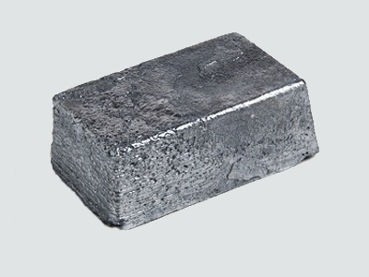
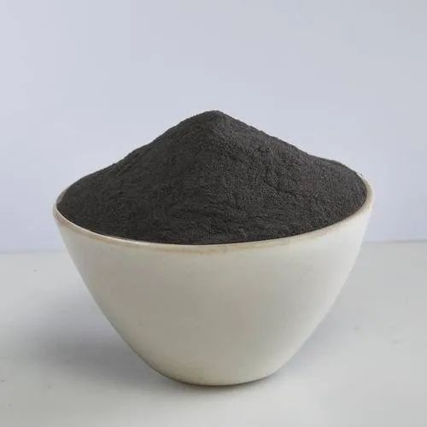
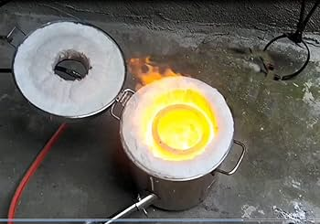

POLYNOMIALS
LAGRANGE OR DIVIDED DIFFERENCE

Slide 3
PROBLEM 1
From the Following data, find $f^{′}\left(10\right) and f^{′′}\left(5\right)$
X | 3 | 5 | 11 | 27 | 34
f(x) | -13 | 23 | 899 | 17315 | 35606
STEP 1 : Use Lagrange or divided Difference

Slide 4
STEP 2 : make polynomials
STEP 3 : Differentiate and Find the Value

Slide 5
1) From the following values of x and y find $f^{′}\left(1.2\right)and f^{′′}(1.2)$
X | 1 | 2 | 3 | 4 | 5
y | 0 | 1 | 5 | 6 | 8
2) From the following values of x and y find $f^{′}\left(3\right)and f^{′′}(3)$
X | 0 | 2 | 3 | 4 | 7 | 9
F(x) | 4 | 26 | 58 | 112 | 466 | 922

